Slide 1
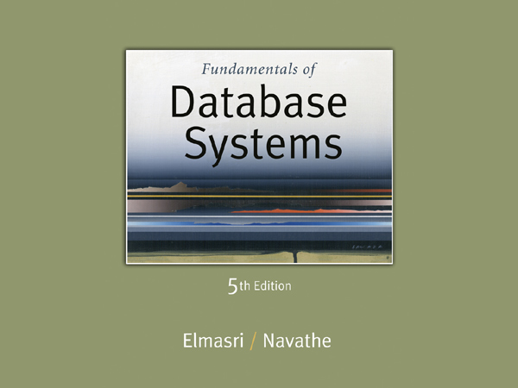

Slide 2
Chapter 18
Concurrency Control Techniques

Slide 3
Chapter 18 Outline
Databases Concurrency Control
Purpose of Concurrency Control
Two-Phase locking
Limitations of CCMs
Index Locking
Lock Compatibility Matrix
Lock Granularity

Slide 4
Database Concurrency Control
1 Purpose of Concurrency Control
To enforce Isolation (through mutual exclusion) among conflicting transactions.
To preserve database consistency through consistency preserving execution of transactions.
To resolve read-write and write-write conflicts.
Example:
In concurrent execution environment if T1 conflicts with T2 over a data item A, then the existing concurrency control decides if T1 or T2 should get the A and if the other transaction is rolled-back or waits.

Slide 5
Database Concurrency Control
Two-Phase Locking Techniques
Locking is an operation which secures
(a) permission to Read
(b) permission to Write a data item for a transaction.
Example:
Lock (X). Data item X is locked in behalf of the requesting transaction.
Unlocking is an operation which removes these permissions from the data item.
Example:
Unlock (X): Data item X is made available to all other transactions.
Lock and Unlock are Atomic operations.

Slide 6
Database Concurrency Control
Two-Phase Locking Techniques: Essential components
Two locks modes:
(a) shared (read) (b) exclusive (write).
Shared mode: shared lock (X)
More than one transaction can apply share lock on X for reading its value but no write lock can be applied on X by any other transaction.
Exclusive mode: Write lock (X)
Only one write lock on X can exist at any time and no shared lock can be applied by any other transaction on X.
Conflict matrix

Slide 7
Database Concurrency Control
Two-Phase Locking Techniques: Essential components
Lock Manager:
Managing locks on data items.
Lock table:
Lock manager uses it to store the identify of transaction locking a data item, the data item, lock mode and pointer to the next data item locked. One simple way to implement a lock table is through linked list.

Slide 8
Database Concurrency Control
Two-Phase Locking Techniques: Essential components
Database requires that all transactions should be well-formed. A transaction is well-formed if:
It must lock the data item before it reads or writes to it.
It must not lock an already locked data items and it must not try to unlock a free data item.

Slide 9
Database Concurrency Control
Two-Phase Locking Techniques: Essential components
The following code performs the lock operation:
B: if LOCK (X) = 0 (*item is unlocked*)
then LOCK (X) ← 1 (*lock the item*)
else begin
wait (until lock (X) = 0) and
the lock manager wakes up the transaction);
goto B
end;

Slide 10
Database Concurrency Control
Two-Phase Locking Techniques: Essential components
The following code performs the unlock operation:
LOCK (X) ← 0 (*unlock the item*)
if any transactions are waiting then
wake up one of the waiting the transactions;

Slide 11
Database Concurrency Control
Two-Phase Locking Techniques: Essential components
The following code performs the read operation:
B: if LOCK (X) = “unlocked” then
begin LOCK (X) ← “read-locked”;
no_of_reads (X) ← 1;
end
else if LOCK (X) ← “read-locked” then
no_of_reads (X) ← no_of_reads (X) +1
else begin wait (until LOCK (X) = “unlocked” and
the lock manager wakes up the transaction);
go to B
end;

Slide 12
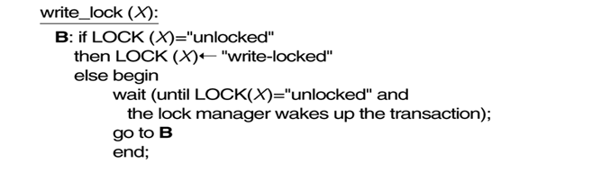
Database Concurrency Control
Two-Phase Locking Techniques: Essential components
The following code performs the write lock operation:

Slide 13
Database Concurrency Control
Two-Phase Locking Techniques: Essential components
The following code performs the unlock operation:
if LOCK (X) = “write-locked” then
begin LOCK (X) ← “unlocked”;
wakes up one of the transactions, if any
end
else if LOCK (X) ← “read-locked” then
begin
no_of_reads (X) ← no_of_reads (X) -1
if no_of_reads (X) = 0 then
begin
LOCK (X) = “unlocked”;
wake up one of the transactions, if any
end
end;

Slide 14
Database Concurrency Control
Two-Phase Locking Techniques: Essential components
Lock conversion
Lock upgrade: existing read lock to write lock
if Ti has a read-lock (X) and Tj has no read-lock (X) (i ≠ j) then
convert read-lock (X) to write-lock (X)
else
force Ti to wait until Tj unlocks X
Lock downgrade: existing write lock to read lock
Ti has a write-lock (X) (*no transaction can have any lock on X*)
convert write-lock (X) to read-lock (X)

Slide 15
Problem with previous Locking Style/Pattern
T1 | T2
LOCK-X(A)
R(A)
W(A)
UNLOCK(A)
 | LOCK-S(B)
 | R(B)
 | UNLOCK(B)
LOCK-X(B)
R(B)
W(B)
UNLOCK(B)
 | LOCK-S(A)
 | R(A)
 | UNLOCK(A)
It is evident from the schedule that the transactions are well formed, as they lock an item before use and then unlock the items after use.
But still neither of the essential properties hold:
Conflict serializability
View Serializability
Being Cascade less
Recoverability

Slide 16
Problem with previous Locking Style/Pattern
T1 | T2
LOCK-X(A)
R(A)
W(A)
UNLOCK(A)
 | LOCK-S(B)
 | R(B)
 | UNLOCK(B)
LOCK-X(B)
R(B)
W(B)
UNLOCK(B)
 | LOCK-S(A)
 | R(A)
 | UNLOCK(A)
T1
CYCLE
T2
Non Conflict serializable
Non View Serializable
May have Cascade Rollbacks
May become Irrecoverable
Dirty read

Slide 17
Problem with previous Locking Style/Pattern
T1 | T2
LOCK-X(A)
R(A)
W(A)
UNLOCK(A)
 | LOCK-S(B)
 | R(B)
 | UNLOCK(B)
LOCK-X(B)
R(B)
W(B)
UNLOCK(B)
 | LOCK-S(A)
 | R(A)
 | UNLOCK(A)
Despite of being well formed the schedule had problems, because in the schedule any transaction is allowed to perform lock operation as and when it needs.
Rather we need a disciplined approach of locking and unlocking. We need to apply some rules so that if not all but atleast few desirable properties are achieved.

Slide 18
Database Concurrency Control
Two-Phase Locking Techniques: The algorithm
Two Phases:
(a) Locking (Growing)
(b) Unlocking (Shrinking).
Locking (Growing) Phase:
A transaction applies locks (read or write) on desired data items one at a time.
Unlocking (Shrinking) Phase:
A transaction unlocks its locked data items one at a time.
Requirement:
For a transaction these two phases must be mutually exclusively, that is, during locking phase unlocking phase must not start and during unlocking phase locking phase must not begin.

Slide 19
Database Concurrency Control
Two-Phase Locking Techniques: The algorithm
T1 T2 Result
read_lock (Y); read_lock (X); Initial values: X=20; Y=30
read_item (Y); read_item (X); Result of serial execution
unlock (Y); unlock (X); T1 followed by T2
write_lock (X); Write_lock (Y); X=50, Y=80.
read_item (X); read_item (Y); Result of serial execution
X:=X+Y; Y:=X+Y; T2 followed by T1
write_item (X); write_item (Y); X=70, Y=50
unlock (X); unlock (Y);

Slide 20
Database Concurrency Control
Two-Phase Locking Techniques: The algorithm
T1 T2 Result
read_lock (Y); X=50; Y=50
read_item (Y); Nonserializable because it.
unlock (Y); violated two-phase policy.
read_lock (X);
read_item (X);
unlock (X);
write_lock (Y);
read_item (Y);
Y:=X+Y;
write_item (Y);
unlock (Y);
write_lock (X);
read_item (X);
X:=X+Y;
write_item (X);
unlock (X);
Time

Slide 21
Problem with previous Locking Style/Pattern
T1 | T2
LOCK-X(A)
R(A)
W(A)
UNLOCK(A)
 | LOCK-S(A)
 | R(A)
 | UNLOCK(A)
 | C
C/FAIL
It is evident from the schedule that the transactions follow 2PL
But still neither of the essential properties hold:
Being Cascade less
Recoverability
T2 read A written by transaction T1 now if T1 fails then cascaded rollbacks are required
Imagine that if T1 fails after T2 commits then Schedule becomes Irrecoverable

Slide 22
Database Concurrency Control
Two-Phase Locking Techniques: DEADLOCK PROBLEM
T1 T2
read_lock (Y);
read_item (Y);
write_lock (X);
T1 & T2 follow two-phase policy but still subject to deadlock which must be dealt with
read_lock (X);
read_item (X);
write_lock (Y);
unlock (X);
read_item (Y);
Y:=X+Y;
write_item (Y);
unlock (Y);
unlock (Y);
read_item (X);
X:=X+Y;
write_item (X);
unlock (X);
Time

Slide 23
Database Concurrency Control
Two-Phase Locking Techniques: The algorithm
Two-phase policy generates two locking algorithms
(a) Basic
(b) Conservative
Basic:
Transaction locks data items incrementally. This may cause deadlock which is dealt with.
Conservative:
Prevents deadlock by locking all desired data items before transaction begins execution.
Strict:
A more stricter version of Basic algorithm where unlocking is performed after a transaction terminates (commits or aborts and rolled-back). This is the most commonly used two-phase locking algorithm.

Slide 24
Database Concurrency Control
Dealing with Deadlock and Starvation
Deadlock
T’1 T’2
read_lock (Y); T1 and T2 did follow two-phase
read_item (Y); policy but they are deadlock
read_lock (X);
read_item (Y);
write_lock (X);
(waits for X) write_lock (Y);
(waits for Y)
Deadlock (T’1 and T’2)

Slide 25
Database Concurrency Control
Dealing with Deadlock and Starvation
Deadlock prevention
A transaction locks all data items it refers to before it begins execution.
This way of locking prevents deadlock since a transaction never waits for a data item.
The conservative two-phase locking uses this approach.

Slide 26
Database Concurrency Control
Dealing with Deadlock and Starvation
Deadlock detection and resolution
In this approach, deadlocks are allowed to happen. The scheduler maintains a wait-for-graph for detecting cycle. If a cycle exists, then one transaction involved in the cycle is selected (victim) and rolled-back.
A wait-for-graph is created using the lock table. As soon as a transaction is blocked, it is added to the graph. When a chain like: Ti waits for Tj waits for Tk waits for Ti or Tj occurs, then this creates a cycle. One of the transaction is aborted

Slide 27
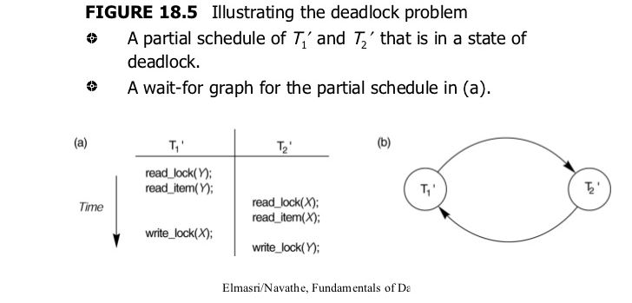

Slide 28
Database Concurrency Control
Dealing with Deadlock and Starvation
Deadlock avoidance
There are many variations of two-phase locking algorithm.
Some avoid deadlock by not letting the cycle to complete.
That is as soon as the algorithm discovers that blocking a transaction is likely to create a cycle, it rolls back the transaction.
Wound-Wait and Wait-Die algorithms use timestamps to avoid deadlocks by rolling-back victim.

Slide 29
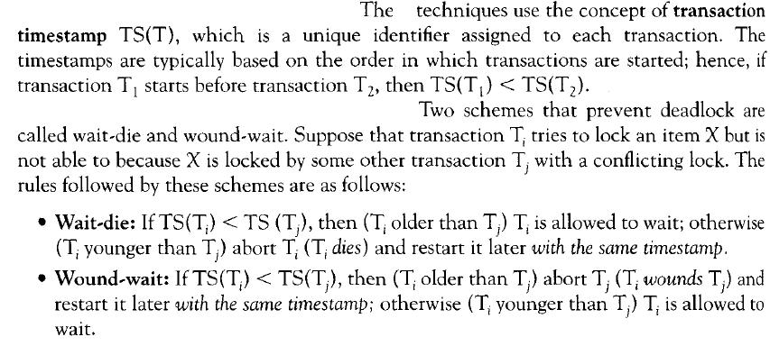
Deadlock Prevention Techniques

Slide 30
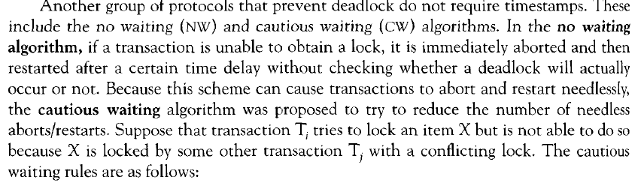
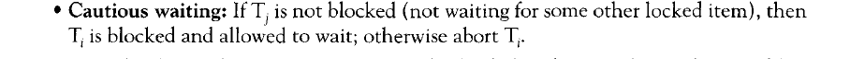

Slide 31
Database Concurrency Control
Dealing with Deadlock and Starvation
Starvation
Starvation occurs when a particular transaction consistently waits or restarted and never gets a chance to proceed further.
In a deadlock resolution it is possible that the same transaction may consistently be selected as victim and rolled-back.
This limitation is inherent in all priority based scheduling mechanisms.
In Wound-Wait scheme a younger transaction may always be wounded (aborted) by a long running older transaction which may create starvation.

Slide 32
Database Concurrency Control
Timestamp based concurrency control algorithm
Timestamp
A monotonically increasing variable (integer) indicating the age of an operation or a transaction. A larger timestamp value indicates a more recent event or operation.
Timestamp based algorithm uses timestamp to serialize the execution of concurrent transactions.

Slide 33
Database Concurrency Control
Timestamp based concurrency control algorithm
Basic Timestamp Ordering
1. Transaction T issues a write_item(X) operation:
If read_TS(X) > TS(T) or if write_TS(X) > TS(T), then an younger transaction has already read the data item so abort and roll-back T and reject the operation.
If the condition in part (a) does not exist, then execute write_item(X) of T and set write_TS(X) to TS(T).
2. Transaction T issues a read_item(X) operation:
If write_TS(X) > TS(T), then an younger transaction has already written to the data item so abort and roll-back T and reject the operation.
If write_TS(X) ≤ TS(T), then execute read_item(X) of T and set read_TS(X) to the larger of TS(T) and the current read_TS(X).

Slide 34
TIMESTAMP OF TRANSACTIONS
TS(T1)=5
TS(T2)=10
T1 | T2
R(A)
 | R(A)
 | W(A)
W(A)
TIMESTAMP OF DATA ITEM
READ TIMESTAMP OF DATA ITEM
RTS(A)=10
WRITE TIMESTAMP OF DATA ITEM
WTS(A)=10

Slide 35
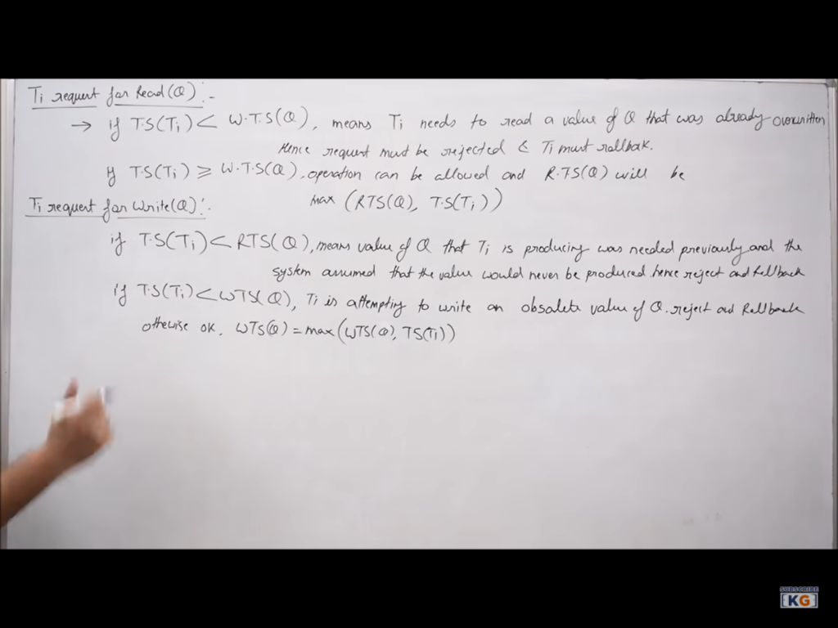

Slide 36
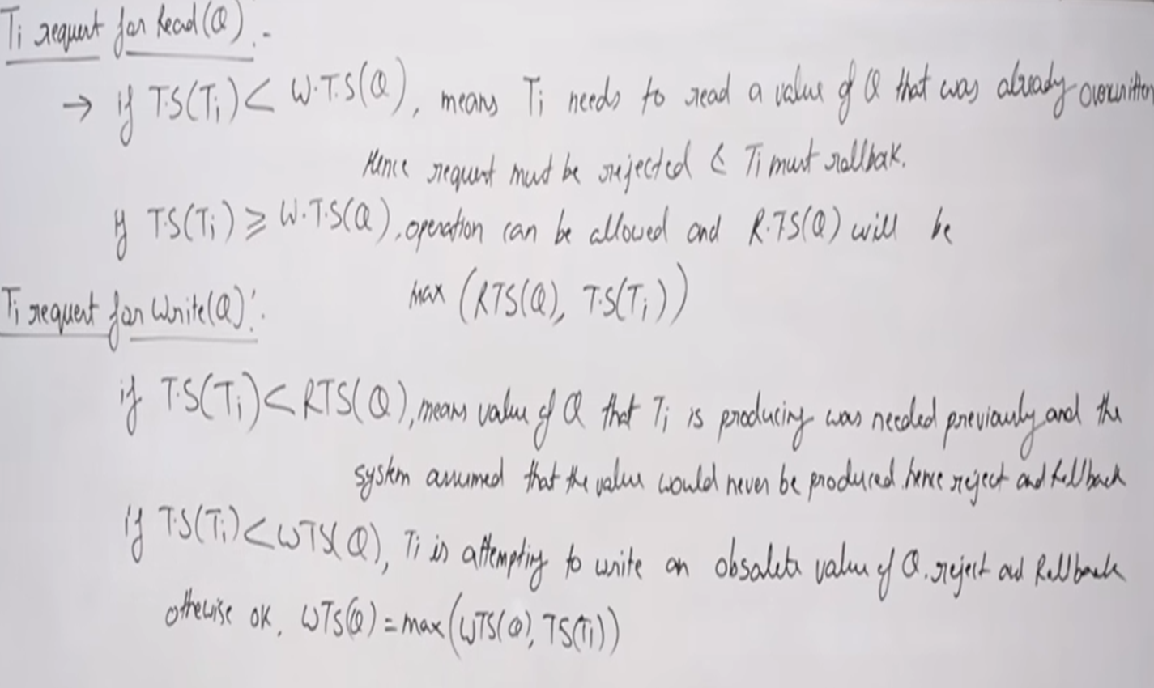
TIMESTAMP OF TRANSACTIONS
TS(T1)=5
TS(T2)=10
T1 | T2
 | W(A)
TIMESTAMP OF DATA ITEM
WRITE TIMESTAMP OF DATA ITEM A
WTS(A)=10
R(A)
ROLLBACK T1 AND DONOT ALLOW READING

Slide 37
TIMESTAMP OF TRANSACTIONS
TS(T1)=10
TS(T2)=5
T1 | T2
 | R(A)
 | W(A)
TIMESTAMP OF DATA ITEM
WRITE TIMESTAMP OF DATA ITEM A
WTS(A)=5
R(A)
ALLOW READING

Slide 38
Database Concurrency Control
Timestamp based concurrency control algorithm
Strict Timestamp Ordering
1. Transaction T issues a write_item(X) operation:
If TS(T) > read_TS(X), then delay T until the transaction T’ that wrote or read X has terminated (committed or aborted).
2. Transaction T issues a read_item(X) operation:
If TS(T) > write_TS(X), then delay T until the transaction T’ that wrote or read X has terminated (committed or aborted).

Slide 39
THANK YOU

Slide 42
Database Concurrency Control
Timestamp based concurrency control algorithm
Thomas’s Write Rule
If read_TS(X) > TS(T) then abort and roll-back T and reject the operation.
If write_TS(X) > TS(T), then just ignore the write operation and continue execution. This is because the most recent writes counts in case of two consecutive writes.
If the conditions given in 1 and 2 above do not occur, then execute write_item(X) of T and set write_TS(X) to TS(T).

